Slide 1
Data Warehousing Concepts
Transparencies
© Pearson Education Limited 1995, 2005
Notes:
September 98
1
Chapter Name

Slide 2
- Objectives
How data warehousing evolved.
The main concepts and benefits associated with data warehousing.
How online transaction processing (OLTP) systems differ from data warehousing.
The problems associated with data warehousing.
© Pearson Education Limited 1995, 2005

Slide 3
Objectives
The architecture and main components of a data warehouse.
The important information flows or processes of a data warehouse.
The main tools and technologies associated with data warehousing.
© Pearson Education Limited 1995, 2005

Slide 4
Objectives
The issues associated with the integration of a data warehouse and the importance of managing metadata.
The concept of a data mart and the main reasons for implementing a data mart.
The advantages and disadvantages of a data mart.
© Pearson Education Limited 1995, 2005

Slide 5
- Objectives
The main issues associated with the development and management of data marts.
How Oracle supports the requirements of data warehousing.
© Pearson Education Limited 1995, 2005

Slide 6
The Evolution of Data Warehousing
Since 1970s, organizations gained competitive advantage through systems that automate business processes to offer more efficient and cost-effective services to the customer.
This resulted in accumulation of growing amounts of data in operational databases.
© Pearson Education Limited 1995, 2005

Slide 7
The Evolution of Data Warehousing
Organizations now focus on ways to use operational data to support decision-making, as a means of gaining competitive advantage.
However, operational systems were never designed to support such business activities.
Businesses typically have numerous operational systems with overlapping and sometimes contradictory definitions.
© Pearson Education Limited 1995, 2005

Slide 8
The Evolution of Data Warehousing
Organizations need to turn their archives of data into a source of knowledge, so that a single integrated / consolidated view of the organization’s data is presented to the user.
A data warehouse was deemed the solution to meet the requirements of a system capable of supporting decision-making, receiving data from multiple operational data sources.
© Pearson Education Limited 1995, 2005

Slide 9
Data Warehousing Concepts
A subject-oriented, integrated, time-variant, and non-volatile collection of data in support of management’s decision-making process (Inmon, 1993).
© Pearson Education Limited 1995, 2005

Slide 10
Subject-oriented Data
The warehouse is organized around the major subjects of the enterprise (e.g. customers, products, and sales) rather than the major application areas (e.g. customer invoicing, stock control, and product sales).
This is reflected in the need to store decision-support data rather than application-oriented data.
© Pearson Education Limited 1995, 2005

Slide 11
Integrated Data
The data warehouse integrates corporate application-oriented data from different source systems, which often includes data that is inconsistent.
The integrated data source must be made consistent to present a unified view of the data to the users.
© Pearson Education Limited 1995, 2005

Slide 12
Time-variant Data
Data in the warehouse is only accurate and valid at some point in time or over some time interval.
Time-variance is also shown in the extended time that the data is held, the implicit or explicit association of time with all data, and the fact that the data represents a series of snapshots.
© Pearson Education Limited 1995, 2005

Slide 13
Non-volatile Data
Data in the warehouse is not updated in real-time but is refreshed from operational systems on a regular basis.
New data is always added as a supplement to the database, rather than a replacement.
© Pearson Education Limited 1995, 2005

Slide 14
Data Webhouse
The Web is an immense source of behavioral data as individuals interact through their Web browsers with remote Web sites. The data generated by this behavior is called clickstream.
A data webhouse is a distributed data warehouse with no central data repository that is implemented over the Web to harness clickstream data.
© Pearson Education Limited 1995, 2005

Slide 15
Benefits of Data Warehousing
Potential high returns on investment
Competitive advantage
Increased productivity of corporate decision-makers
© Pearson Education Limited 1995, 2005

Slide 16
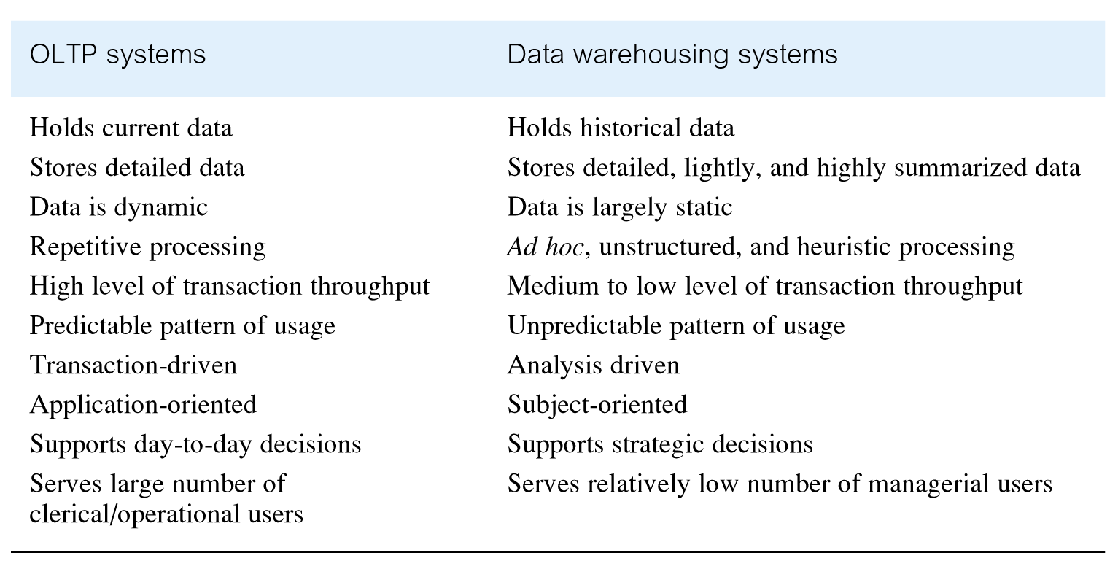
Comparison of OLTP Systems and Data Warehousing
© Pearson Education Limited 1995, 2005

Slide 17
Data Warehouse Queries
The types of queries that a data warehouse is expected to answer ranges from the relatively simple to the highly complex and is dependent on the type of end-user access tools used.
End-user access tools include:
Reporting, query, and application development tools
Executive information systems (EIS)
OLAP tools
Data mining tools
© Pearson Education Limited 1995, 2005

Slide 18
Examples of Typical Data Warehouse Queries
What was the total revenue for Scotland in the third quarter of 2004?
What was the total revenue for property sales for each type of property in Great Britain in 2003?
What are the three most popular areas in each city for the renting of property in 2004 and how does this compare with the figures for the previous two years?
What is the monthly revenue for property sales at each branch office, compared with rolling 12-monthly prior figures?
What would be the effect on property sales in the different regions of Britain if legal costs went up by 3.5% and Government taxes went down by 1.5% for properties over £100,000?
Which type of property sells for prices above the average selling price for properties in the main cities of Great Britain and how does this correlate to demographic data?
What is the relationship between the total annual revenue generated by each branch office and the total number of sales staff assigned to each branch office?
© Pearson Education Limited 1995, 2005

Slide 19
Problems of Data Warehousing
Underestimation of resources for data loading
Hidden problems with source systems
Required data not captured
Increased end-user demands
Data homogenization
© Pearson Education Limited 1995, 2005

Slide 20
Problems of Data Warehousing
High demand for resources
Data ownership
High maintenance
Long duration projects
Complexity of integration
© Pearson Education Limited 1995, 2005

Slide 21
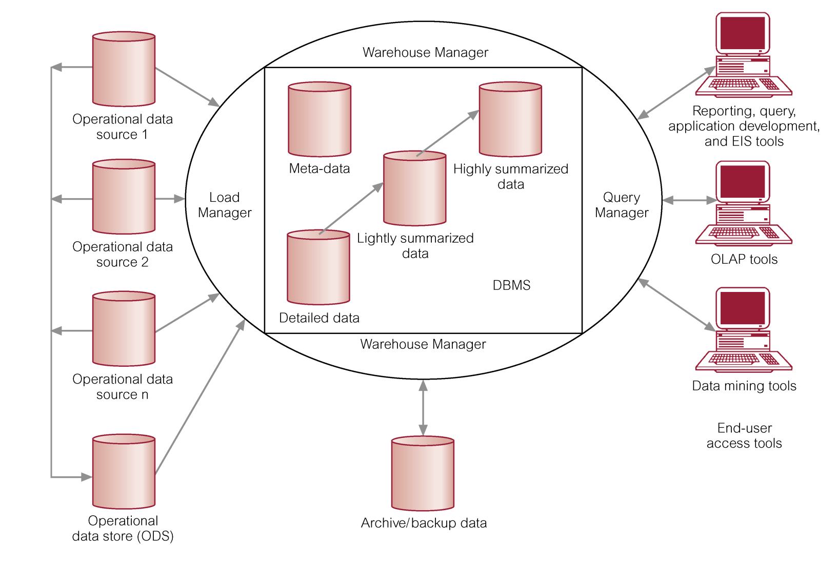
Typical Architecture of a Data Warehouse
© Pearson Education Limited 1995, 2005

Slide 22
Operational Data Sources
Mainframe first generation hierarchical and network databases.
Departmental propriety file systems (e.g. VSAM, RMS) and relational DBMSs (e.g. Informix, Oracle).
Private workstations and servers.
External systems such as the internet, commercially available databases, or databases associated with an organization’s suppliers or customers.
© Pearson Education Limited 1995, 2005

Slide 23
Operational Data Store (ODS)
A repository of current and integrated operational data used for analysis.
Often structured and supplied with data in the same way as the data warehouse.
May act simply as a staging area for data to be moved into the warehouse.
Often created when legacy operational systems are found to be incapable of achieving reporting requirements.
Provides users with the ease-of-use of a relational database while remaining distant from the decision support functions of the data warehouse.
© Pearson Education Limited 1995, 2005

Slide 24
Load Manager
Performs all the operations associated with the extraction and loading of data into the warehouse.
Size and complexity will vary between data warehouses and may be constructed using a combination of vendor data loading tools and custom-built programs.
© Pearson Education Limited 1995, 2005

Slide 25
Warehouse Manager
Performs all the operations associated with the management of the data in the warehouse.
Constructed using vendor data management tools and custom-built programs.
© Pearson Education Limited 1995, 2005

Slide 26
Warehouse Manager
Operations performed include
Analysis of data to ensure consistency.
Transformation and merging of source data from temporary storage into data warehouse tables.
Creation of indexes and views on base tables.
Generation of denormalizations, (if necessary).
Generation of aggregations, (if necessary).
Backing-up and archiving data.
© Pearson Education Limited 1995, 2005

Slide 27
Warehouse Manager
In some cases, also generates query profiles to determine which indexes and aggregations are appropriate.
A query profile can be generated for each user, group of users, or the data warehouse and is based on information that describes the characteristics of the queries such as frequency, target table(s), and size of results set.
© Pearson Education Limited 1995, 2005

Slide 28
Query Manager
Performs all the operations associated with the management of user queries.
Typically constructed using vendor end-user data access tools, data warehouse monitoring tools, database facilities, and custom-built programs.
Complexity determined by the facilities provided by the end-user access tools and the database.
© Pearson Education Limited 1995, 2005

Slide 29
Query Manager
The operations performed by this component include directing queries to the appropriate tables and scheduling the execution of queries.
In some cases, the query manager also generates query profiles to allow the warehouse manager to determine which indexes and aggregations are appropriate.
© Pearson Education Limited 1995, 2005

Slide 30
Detailed Data
Stores all the detailed data in the database schema.
In most cases, the detailed data is not stored online but aggregated to the next level of detail.
On a regular basis, detailed data is added to the warehouse to supplement the aggregated data.
© Pearson Education Limited 1995, 2005

Slide 31
Lightly and Highly Summarized Data
Stores all the pre-defined lightly and highly aggregated data generated by the warehouse manager.
Transient as it will be subject to change on an on-going basis in order to respond to changing query profiles.
© Pearson Education Limited 1995, 2005

Slide 32
Lightly and Highly Summarized Data
The purpose of summary information is to speed up the performance of queries.
Removes the requirement to continually perform summary operations (such as sort or group by) in answering user queries.
The summary data is updated continuously as new data is loaded into the warehouse.
© Pearson Education Limited 1995, 2005

Slide 33
Archive / Backup Data
Stores detailed and summarized data for the purposes of archiving and backup.
May be necessary to backup online summary data if this data is kept beyond the retention period for detailed data.
The data is transferred to storage archives such as magnetic tape or optical disk.
© Pearson Education Limited 1995, 2005

Slide 34
Metadata
This area of the warehouse stores all the metadata (data about data) definitions used by all the processes in the warehouse.
© Pearson Education Limited 1995, 2005

Slide 35
Metadata
Used for a variety of purposes
Extraction and loading processes - metadata is used to map data sources to a common view of information within the warehouse.
Warehouse management process - metadata is used to automate the production of summary tables.
Query management process - metadata is used to direct a query to the most appropriate data source.
© Pearson Education Limited 1995, 2005

Slide 36
Metadata
The structure of metadata will differ between each process, because the purpose is different.
This means that multiple copies of metadata describing the same data item are held within the data warehouse.
Most vendor tools for copy management and end-user data access use their own versions of metadata.
© Pearson Education Limited 1995, 2005

Slide 37
Metadata
Copy management tools use metadata to understand the mapping rules to apply in order to convert the source data into a common form.
End-user access tools use metadata to understand how to build a query.
The management of metadata within the data warehouse is a very complex task that should not be underestimated.
© Pearson Education Limited 1995, 2005

Slide 38
End-user Access Tools
The principal purpose of data warehousing is to provide information to business users for strategic decision-making.
These users interact with the warehouse using end-user access tools.
The data warehouse must efficiently support ad hoc and routine analysis.
© Pearson Education Limited 1995, 2005

Slide 39
End-user Access Tools
High performance is achieved by pre-planning the requirements for joins, summations, and periodic reports by end-users (where possible).
There are five main groups of access tools
Data reporting and query tools
Application development tools
Executive information system (EIS) tools
Online analytical processing (OLAP) tools
Data mining tools
© Pearson Education Limited 1995, 2005

Slide 40
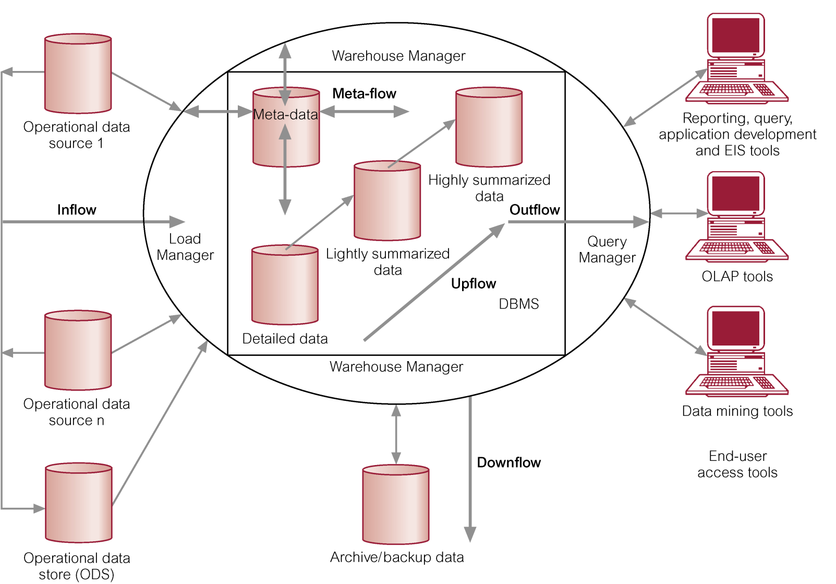
Data Warehouse Information Flows
© Pearson Education Limited 1995, 2005

Slide 41
Data Warehouse Information Flows
Inflow - Processes associated with the extraction, cleansing, and loading of the data from the source systems into the data warehouse.
Upflow - Processes associated with adding value to the data in the warehouse through summarizing, packaging, and distribution of the data.
© Pearson Education Limited 1995, 2005

Slide 42
Data Warehouse Information Flows
Downflow - Processes associated with archiving and backing-up/recovery of data in the warehouse.
Outflow - Processes associated with making the data available to the end-users.
Metaflow - Processes associated with the management of the metadata.
© Pearson Education Limited 1995, 2005

Slide 43
Data Warehousing Tools and Technologies
Building a data warehouse is a complex task because there is no vendor that provides an ‘end-to-end’ set of tools.
Necessitates that a data warehouse is built using multiple products from different vendors.
Ensuring that these products work well together and are fully integrated is a major challenge.
© Pearson Education Limited 1995, 2005

Slide 44
Extraction, Cleansing, and Transformation Tools
Tasks of capturing data from source systems, cleansing and transforming it, and loading the results into a target system can be carried out either by separate products, or by a single integrated solution.
Integrated solutions include
Code Generators
Database Data Replication Tools
Dynamic Transformation Engines
© Pearson Education Limited 1995, 2005

Slide 45
Data Warehouse DBMS Requirements
Load performance
Load processing
Data quality management
Query performance
Terabyte scalability
Mass user scalability
Networked data warehouse
Warehouse administration
Integrated dimensional analysis
Advanced query functionality
© Pearson Education Limited 1995, 2005

Slide 46
Data Warehouse Parallel Database Technologies
Aims to solve decision-support problems using multiple nodes working on the same problem.
Performs many database operations simultaneously, splitting individual tasks into smaller parts so that tasks can be spread across multiple processors.
Parallel DBMSs must be capable of running parallel queries, parallel data loading, table scanning, and data archiving, and back up.
© Pearson Education Limited 1995, 2005

Slide 47
Data Warehouse Parallel Database Technologies
Two main parallel hardware architectures include
Symmetric Multi-processing (SMP)
Massively Parallel Processing (MPP)
SMP - A set of tightly coupled processors that share memory and disk storage.
MPP - A set of loosely coupled processors, each of which has its own memory and disk storage.
© Pearson Education Limited 1995, 2005

Slide 48
Data Warehouse Metadata
Metadata is used for a variety of purposes and management of metadata is a critical issue in achieving a fully integrated data warehouse.
The major purpose of metadata is to show the pathway back to where the data began, so that the warehouse administrators know the history of any item in the warehouse.
Problem is that metadata has several functions in the data warehouse.
Data transformation and loading
Data warehouse management
Query generation
© Pearson Education Limited 1995, 2005

Slide 49
Data Warehouse Metadata
Problem is that metadata has several functions in the data warehouse.
Data transformation and loading
Data warehouse management
Query generation
Various tools of data warehouse generate and use their own metadata. Major challenge is to synchronize the various types of metadata.
© Pearson Education Limited 1995, 2005

Slide 50
Data Warehouse Metadata
Two industry organizations: the Meta Data Coalition (MDC) and the Object Management Group (OMG) have merged to propose a single standard for metadata and modeling in data warehousing called the Common Warehouse Metamodel (CWM).
Allows users to exchange metadata between different products from different vendors freely.
© Pearson Education Limited 1995, 2005

Slide 51
Administration and Management Tools
Monitoring data loading from multiple sources.
Data quality and integrity checks.
Managing and updating metadata.
Monitoring database performance to ensure efficient query response times and resource utilization.
Auditing data warehouse usage to provide user chargeback information.
© Pearson Education Limited 1995, 2005

Slide 52
Administration and Management Tools
Replicating, subsetting, and distributing data.
Maintaining efficient data storage management.
Purging data.
Archiving and backing-up data.
Implementing recovery following failure.
Security management.
© Pearson Education Limited 1995, 2005

Slide 53
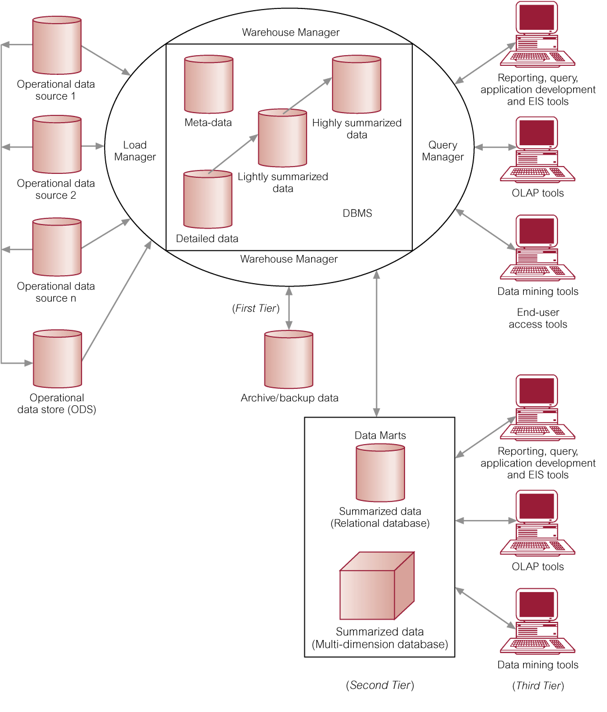
Typical Data Warehouse and Data Mart Architecture
© Pearson Education Limited 1995, 2005

Slide 54
Data Mart
A subset of a data warehouse that supports the requirements of a particular department or business function.
Characteristics include
Focuses on only the requirements of one department or business function.
Do not normally contain detailed operational data unlike data warehouses.
More easily understood and navigated.
© Pearson Education Limited 1995, 2005

Slide 55
Reasons for Creating a Data Mart
To give users access to the data they need to analyze most often.
To provide data in a form that matches the collective view of the data by a group of users in a department or business function area.
To improve end-user response time due to the reduction in the volume of data to be accessed.
© Pearson Education Limited 1995, 2005

Slide 56
Reasons for Creating a Data Mart
To provide appropriately structured data as dictated by the requirements of the end-user access tools.
Building a data mart is simpler compared with establishing a corporate data warehouse.
The cost of implementing data marts is normally less than that required to establish a data warehouse.
© Pearson Education Limited 1995, 2005

Slide 57
Reasons for Creating a Data Mart
The potential users of a data mart are more clearly defined and can be more easily targeted to obtain support for a data mart project rather than a corporate data warehouse project.
© Pearson Education Limited 1995, 2005

Slide 58
Data Marts Issues
Data mart functionality
Data mart size
Data mart load performance
Users access to data in multiple data marts
Data mart Internet / Intranet access
Data mart administration
Data mart installation
© Pearson Education Limited 1995, 2005

